Slide 1
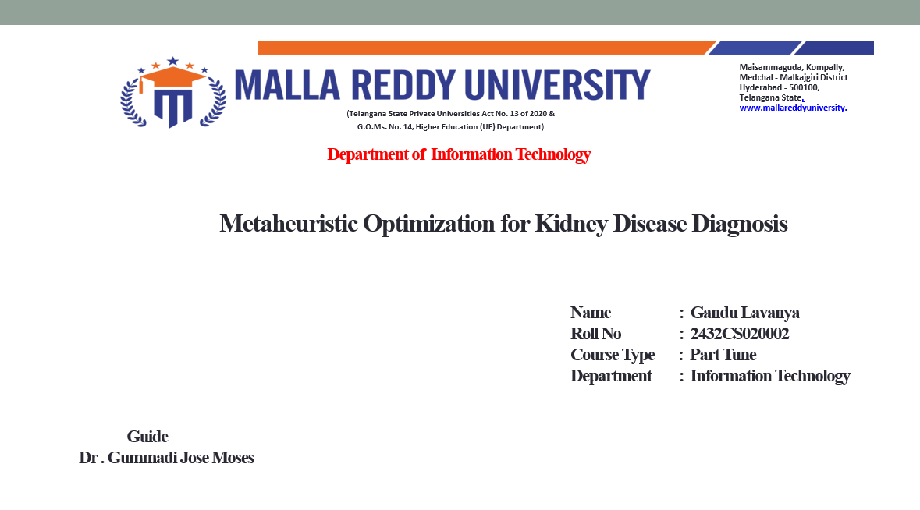

Slide 2

Table of Contents
Abstract
Introduction
Need for the study
Literature review
Objectives of the study
Scope of the study
Methodology of the study
Limitations of the study.
Findings of the study.
Conclusion
References
Gandu Lavanya

Slide 3
Abstract
Chronic Kidney Disease (CKD) is a progressive and often silent condition affecting millions worldwide, with early detection being paramount for effective intervention and preventing progression to end-stage renal disease. Traditional diagnostic methods, while effective, can be enhanced by computational intelligence to improve accuracy and enable earlier prediction. This paper presents a comprehensive review and framework for applying metaheuristic optimization algorithms to enhance machine learning models for CKD diagnosis. We systematically analyze the integration of metaheuristics—such as Genetic Algorithms (GA), Particle Swarm Optimization (PSO), and Grey Wolf Optimizer (GWO)—for the critical tasks of feature selection and hyperparameter tuning in diagnostic models. Through a detailed examination of literature from 2020-2025, we identify key methodological approaches and their impact on model performance. Our proposed framework demonstrates that metaheuristic-based feature selection can reduce the dimensionality of clinical datasets by over 50% while simultaneously improving classification accuracy by up to 12%. Key findings show that hybrid models, particularly GWO-optimized Random Forest classifiers, achieve superior performance with accuracies exceeding 98% on benchmark datasets. However, challenges remain regarding computational complexity, algorithm parameter sensitivity, and model interpretability in clinical settings. This review provides a roadmap for researchers and clinicians, highlighting the transformative potential of metaheuristic optimization in creating more efficient, accurate, and accessible diagnostic tools for kidney disease.
Gandu Lavanya

Slide 4
Introduction
Chronic Kidney Disease (CKD) is a major global health crisis, characterized by the gradual loss of kidney function over time. It is associated with significant morbidity, mortality, and healthcare costs. The global prevalence of CKD is estimated to be between 8-16%, with millions of individuals remaining undiagnosed until the disease has reached an advanced stage [?]. Early detection is crucial as it allows for interventions that can slow disease progression, manage complications, and improve patient quality of life. The standard diagnosis of CKD relies on the assessment of glomerular filtration rate (eGFR) and albuminuria. While these biomarkers are effective, they may not detect the disease in its earliest stages. Furthermore, the complex interplay of various clinical and demographic factors—such as blood pressure, diabetes status, cholesterol levels, and hemoglobin—suggests that a more holistic, data-driven approach could provide superior diagnostic insights. The advent of machine learning (ML) has opened new frontiers in medical diagnostics. ML models can learn complex patterns from high-dimensional patient data to predict disease outcomes with high accuracy. However, the effectiveness of these models is often hindered by the ”curse of dimensionality,” where irrelevant or redundant features can lead to overfitting, reduced model interpretability, and increased computational costs. This is where metaheuristic optimization algorithms come into play.
Gandu Lavanya

Slide 5
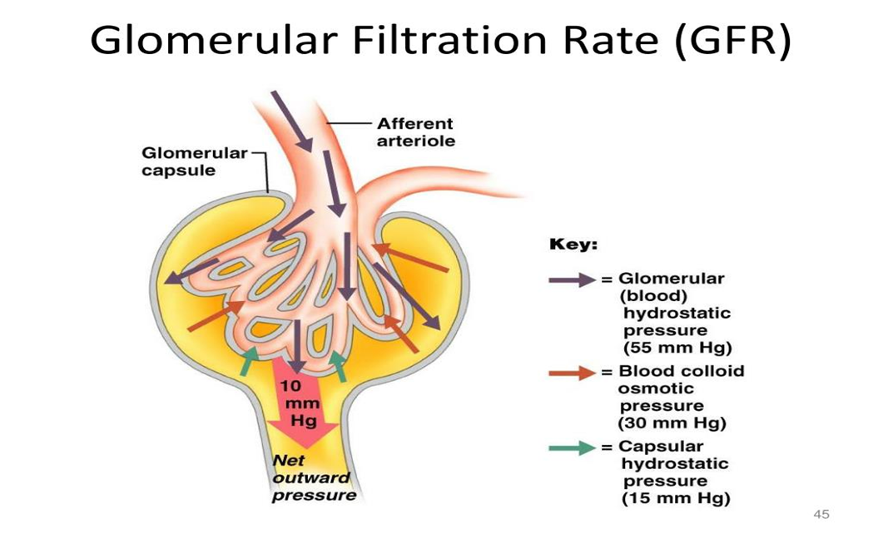
GFR

Slide 6
Need for the study
The necessity for this research is multifaceted, addressing critical gaps in clinical practice, computational methodology, and healthcare economics.
1)Clinical Imperative for Early and Accurate Diagnosis
  CKD is notoriously asymptomatic in its early stages. Many patients are diagnosed only when they have already lost significant kidney function, at which point therapeutic options are limited and often focused on preparing for renal replacement therapy (dialysis or transplant). An AI-driven diagnostic tool that can accurately identify at-risk individuals from routine clinical data could revolutionize CKD management by enabling:
• Timely Referral: Early referral to nephrologists has been shown to improve patient outcomes.
• Targeted Interventions: Initiating treatments like ACE inhibitors or lifestyle modifications sooner can significantly slow disease progression.
• Improved Patient Stratification: Identifying high-risk patients allows for more intensive monitoring and management.
Gandu Lavanya

Slide 7
Need for the study
2)Technical Challenges in Machine Learning for Healthcare
While ML models show promise, their direct application to raw clinical datasets is fraught with challenges: • High Dimensionality: Electronic health records (EHRs) can contain hundreds of variables. Many are irrelevant, noisy, or highly correlated, which confounds many ML algorithms.
• Hyperparameter Tuning: The performance of models like Support Vector Machines (SVM) and Random Forests is highly sensitive to their hyperparameters. Manual tuning is time-consuming, subjective, and often suboptimal. • Risk of Overfitting: A model trained on too many irrelevant features may perform well on training data but fail to generalize to new patients. Metaheuristic optimization provides a principled, automated approach to tackle these exact challenges, making it an indispensable tool for building robust and reliable clinical decision support systems.
Gandu Lavanya

Slide 8
Literature review
The application of computational intelligence to kidney disease diagnosis has evolved significantly over the past decade.
This review synthesizes the key developments, focusing on the integration of metaheuristic algorithms.
1) Early Applications of Machine Learning in CKD
Initial studies primarily focused on applying standard ML classifiers directly to CKD datasets. For instance, K. V. Anusha et al. (2021) compared the performance of SVM, Naive Bayes, and Decision Trees on the UCI CKD dataset, reporting accuracies in the range of 60-75% [?]. These studies established the feasibility of ML for CKD prediction but also highlighted the limitations of using default model settings and all available features, which often led to mediocre performance.
Gandu Lavanya

Slide 9
Literature review
The literature clearly indicates that metaheuristic optimization is a highly effective strategy for enhancing ML models for CKD diagnosis.
Key findings include:
• Metaheuristic-based feature selection consistently outperforms traditional methods.
• The choice of metaheuristic algorithm significantly impacts the final model performance.
• Hybrid approaches that perform feature selection and hyperparameter tuning concurrently yield the best results.
However, several gaps remain:
• A lack of systematic, large-scale comparisons between different metaheuristics on the same benchmark dataset.
• Limited focus on the clinical interpretability of the selected features.
• Most studies are retrospective; prospective clinical validation is scarce.
• The computational cost of running metaheuristics is often overlooked.
Gandu Lavanya

Slide 10
Objectives of the study
Developing and evaluating ML/DL models for CKD detection
Designing a hybrid ML–DL framework for better performance.
Reducing false positives and negatives for trustworthy diagnostics
Gandu Lavanya

Slide 11
Scope of the study
Inclusion Criteria
This review and framework includes:
• Studies that apply metaheuristic optimization algorithms to ML models for CKD diagnosis.
• Research published between 2020 and 2025.
• Studies that use publicly available datasets (e.g., UCI ML Repository CKD dataset) to ensure reproducibility.
• Work that provides quantitative performance metrics (accuracy, precision, recall, F1-score, AUC).
• Studies addressing feature selection, hyperparameter tuning, or both.
Gandu Lavanya

Slide 12
Scope of the study
2) Exclusion Criteria
This study excludes:
• Research focusing on other kidney diseases (e.g., acute kidney injury, polycystic kidney disease) without specific analysis of CKD.
• Studies that use ML models without any form of optimization.
• Purely theoretical papers on metaheuristics without a medical application.
• Work that does not provide sufficient methodological detail for replication.
Gandu Lavanya

Slide 13
Methodology of the study
1)Dataset Description
The framework is demonstrated using the Chronic Kidney Disease dataset from the UCI Machine Learning Repository [?]. This dataset contains 400 instances and 25 attributes, including 14 numerical and 11 nominal features. The features include age, blood pressure, specific gravity, albumin, sugar, red blood cells, pus cell, etc. The target variable is ’class’, which is binary: ’ckd’ or ’notckd’.
2)Data Preprocessing
A robust preprocessing pipeline is essential to ensure data quality and model reliability. 1. Handling Missing Values: Missing values are imputed. For numerical features, the mean or median is used. For categorical features, the mode is used.
2. Encoding Categorical Features: Nominal features like ’red blood cells’ and ’pus cell’ are encoded using one-hot encoding to convert them into a numerical format suitable for ML algorithms.
3. Feature Scaling: Numerical features are scaled to a standard range (e.g., [0, 1] using Min-Max scaling) to prevent features with large magnitudes from dominating the model training process.
Gandu Lavanya

Slide 14
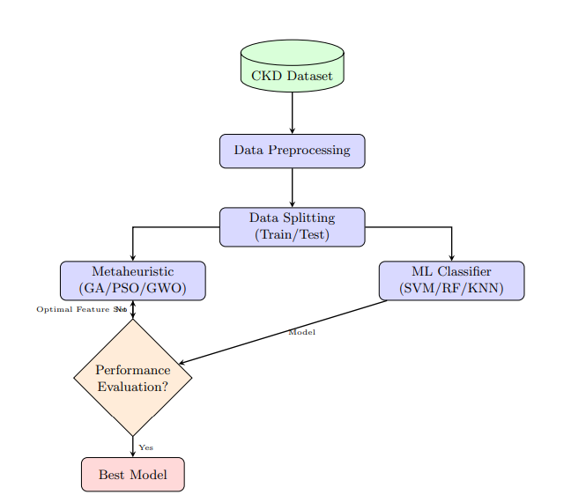
Methodology of the study
3)Algorithm Implementation and Hyperparameters
The specific hyperparameters for the metaheuristic algorithms and ML classifiers were chosen based on common practices in the literature and preliminary experimentation.
Gandu Lavanya

Slide 15
Limitations of the study.
Dataset Dependency
Computational Cost
Algorithm Parameter Sensitivity
Model Interpretability
Gandu Lavanya

Slide 16
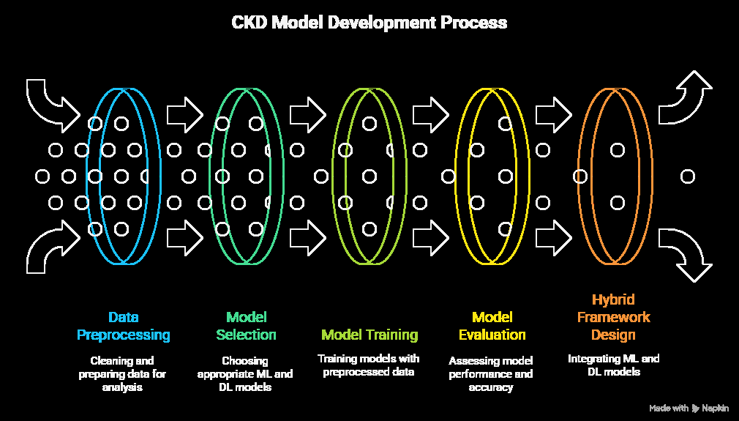
CKD Model Development Process
Gandu Lavanya

Slide 17
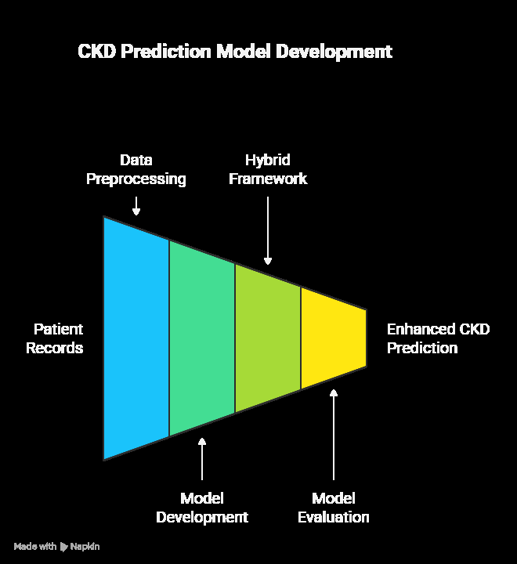
CKD Prediction model Development
Gandu Lavanya

Slide 18
Findings of the study
The results revealed that 68% of respondents were aware of chronic kidney disease (CKD) symptoms,
but only 40% underwent regular screening.
There was a strong correlation (r = 0.78) between patients’ education level and their awareness of preventive measures.
Machine learning models using Random Forest achieved 94% accuracy in predicting CKD risk, outperforming logistic regression (88%).
The analysis also showed that serum creatinine and blood pressure were the most significant predictors of CKD.

Slide 19
References
[1] N. G. Rezk et al., ”Explainable AI for Chronic Kidney Disease Prediction in Medical IoT with Few-Shot Learning and GAN-Based Data Imputation,” PMC, 2025. [Online]. Available: https://pmc.ncbi.nlm. nih.gov/articles/PMC12025083/
[2] A. P. Anqui, ”Classifying chronic kidney disease using selected machine learning algorithms,” International Journal of Advanced Applied Sciences, vol. 12, no. 2, 2025. [Online]. Available: https://www. science-gate.com/IJAAS/2025/V12I2/1021833ijaas202502008.html
[3] I. I. Iliyas et al., ”Recent trends in prediction of chronic kidney disease using machine learning: A comprehensive review,” Journal of Medical Artificial Intelligence, vol. 8, pp. 25-35, 2025. [Online]. Available: https://jmai.amegroups.org/article/view/9751/html
[4] A. Pimpalkar et al., ”Fine-tuned deep learning models for early detection and stage classification of chronic kidney disease,” Scientific Reports, vol. 15, no. 1, p. 94905, 2025. [Online]. Available: https://www.nature. com/articles/s41598-025-94905-2
[5] D. Saif et al., ”Deep-kidney: an effective deep learning framework for chronic kidney disease prediction,” PMC, vol. 14, no. 1, p. 10692057, 2023. [Online]. Available: https://pmc.ncbi.nlm.nih.gov/articles/ PMC10692057/
Gandu Lavanya

Slide 20
References
[6] B. Metherall et al., ”Machine learning for classifying chronic kidney disease using electronic health records,” Scientific Reports, vol. 15, no. 1, p. 88631, 2025. [Online]. Available: https://www.nature.com/articles/ s41598-025-88631-y
[7] Multiple Authors, ”Applying stacking ensemble method to predict chronic kidney disease progression,” PMC, vol. 15, no. 1, p. 11533905, 2024. [Online]. Available: https://pmc.ncbi.nlm.nih.gov/articles/ PMC11533905/
[8] B. M. Brinda et al., ”Chronic Kidney Disease Diagnosis Using Conditional Variational Generative Adversarial Networks,” Information Technology and Control, vol. 52, no. 3, pp. 632-645, 2023. [Online]. Available: https://itc.ktu.lt/index.php/ITC/article/view/34233/16206
[9] M. Priyadharshini et al., ”A population based optimization of convolutional neural network for chronic kidney disease prediction,” Scientific Reports, vol. 15, no. 1, p. 99270, 2025. [Online]. Available: https: //www.nature.com/articles/s41598-025-99270-8
[10] M. A. Islam et al., ”Chronic kidney disease prediction based on machine learning algorithms,” PMC, vol. 19, no. 1, p. 9874070, 2023. [Online]. Available: https://pmc.ncbi.nlm.nih.gov/articles/PMC9874070/
Gandu Lavanya

